Slide 1

Project Swasthya: An Early-Warning System for Environmental Health

Slide 2
A Final Year Project By:
Guide Name
Prof. Yogita
Ashpak Sheikh
Mayur Patil
Rohan Pawar
Sarthak Zunjurke

Slide 3
agenda
The Problem: The Critical Data Gap in Public Health
Our Vision: The Swasthya Solution & Objectives
System Architecture: The 4-Layer Technical Blueprint
Software & AI Design: UML, Class Diagrams & The AI Model
Project Management: Roadmap, Security & Quality
Conclusion: Impact & Future Work

Slide 4
Problem Statement -
The rising levels of air pollution are leading to a significant increase in respiratory and cardiovascular diseases, yet there is no integrated system connecting real-time air quality data with hospital or citizen health records. This lack of correlation prevents timely identification of health trends, weakens preventive healthcare strategies, and limits data-driven policy decisions. The key stakeholders affected include hospitals, environmental agencies, government health departments, and citizens, all of whom face delayed responses, inefficient planning, and reduced public awareness of pollution-related health impacts.

Slide 5
Our Vision & Mission
Project Vision:
A future where every community proactively mitigates environmental health risks.
Project Mission:
To build a privacy-first early-warning system that correlates hyper-local pollutants and real-time health data for actionable insights.

Slide 6
Engaging t Meet the Team & Responsibilitieshe audience
Ashpak Sheikh – Deep Learning & Data Engineering
Lead on AI/ML model development, AWS data pipeline architecture, and Federated Learning strategy
Mayur Patil – IoT & Cloud
Lead on hardware prototyping (ESP32 sensors), device-to-cloud integration (MQTT, IoT Core), and AWS infrastructure management
Rohan Pawar – Full-Stack Development
Lead on Health Official Dashboard (React), MERN backend (Node.js/Express), and data visualization
Sarthak Zunjurke – Full-Stack Development
Lead on Citizen PWA (React), Clinic Data Portal, and User Authentication (Cognito)

Slide 7
Objectives

Slide 8
Detailed Project Objectives (1/2)
Build a Hyper-Local Data Pipeline
• Deploy IoT sensors (ESP32) for real-time PM2.5 and NO₂ data
• Create AWS pipeline using IoT Core, Kinesis, and Lambda
Implement Dual-Channel Health Data Architecture
• Citizen PWA for private symptom data via Federated Learning
• Secure clinic portal for verified aggregated data

Slide 9
Detailed Project Objectives (2/2)
Develop a Hybrid AI Engine
• Federated Learning using Flower framework
• Central Graph Transformer on Amazon SageMaker
Deliver Actionable Insights
• Build interactive dashboard for officials and researchers
• Visualize insights through maps, charts, and alert panels

Slide 10
What is Federated Learning (Simplified)
Central server sends model to user device
Model trains locally on private data
Only anonymous model updates are sent back
Server aggregates updates to improve the global model

Slide 11
High-Level System Architecture
Inputs → Cloud Core → Outputs
Data Sources: IoT Sensors, APIs, PWA, Clinics
Cloud Core: AWS pipeline, databases, and AI engines
Outputs: Dashboards and PWA

Slide 12
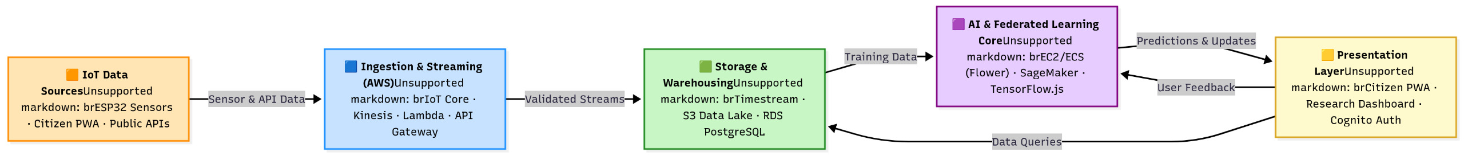
Detailed Technical Architecture

Slide 13
Layer 1 – Ingestion & Streaming
• AWS IoT Core – MQTT-based data ingestion
• Amazon Kinesis – Real-time buffering
• AWS Lambda – Fetches and processes data from sensors and APIs

Slide 14
Layer 2 – Data Storage & Warehousing
• Amazon Timestream – Time-series sensor data
• Amazon S3 – Data lake for raw and processed data
• Amazon RDS (PostgreSQL + PostGIS) – Metadata and geospatial storage

Slide 15
Layer 3 – The AI Core
• Federated Learning Orchestrator – Flower on EC2/ECS
• Central Correlation Engine – Graph Transformer model on SageMaker

Slide 16
Layer 4 – Presentation Layer
Citizen PWA and Health Dashboard built in React
• Amazon API Gateway – Secure access layer
• Amazon Cognito – Authentication and role-based access

Slide 17
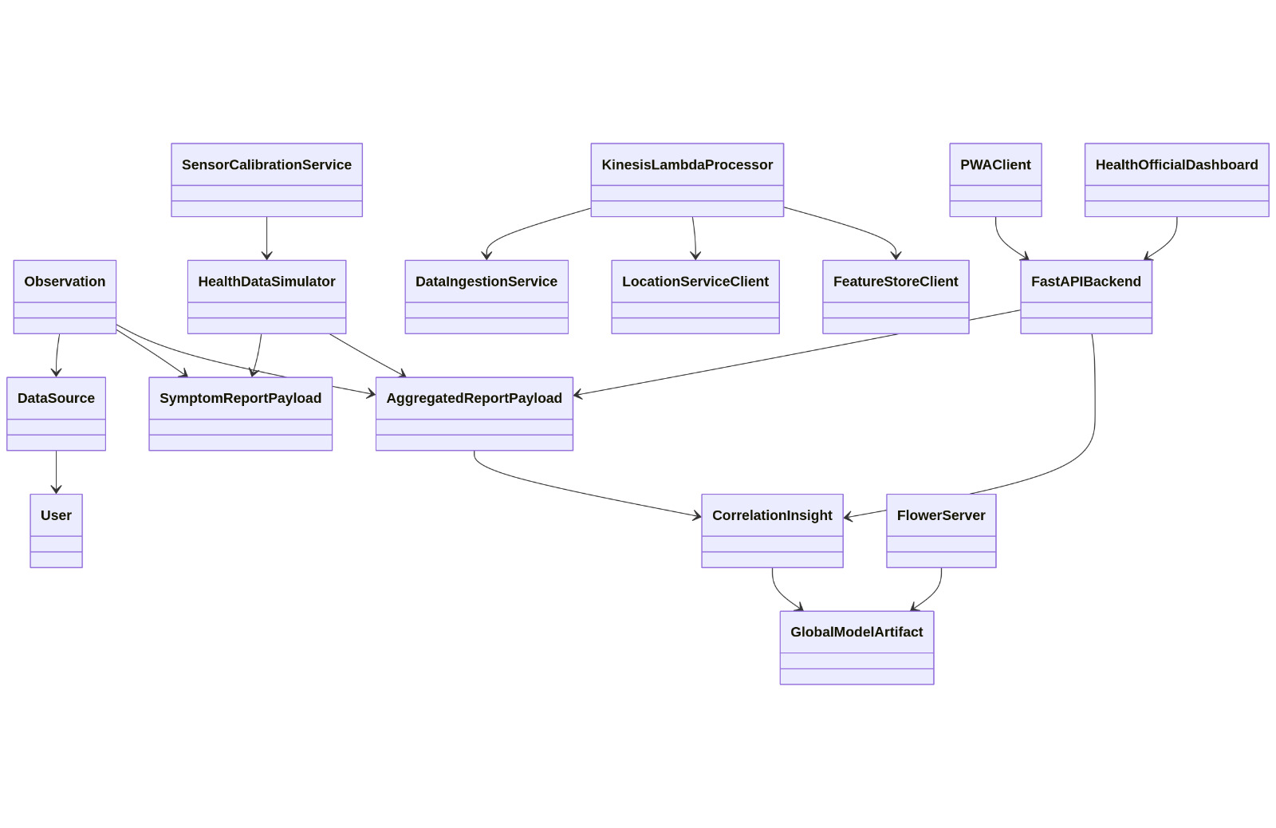
Class Diagram

Slide 18
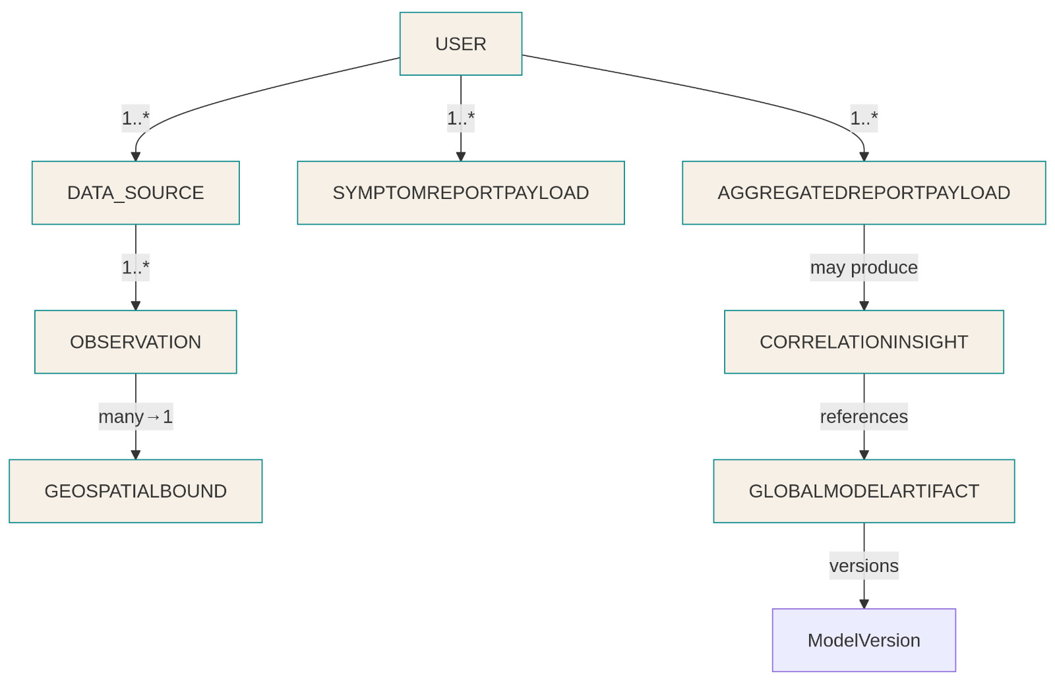
Er Diagram

Slide 19
The AI Model – Graph Transformer
• Graph Neural Network models spatial relations
• Transformer models time-series dependencies
• Combined, they capture both space and time correlations

Slide 20
Project Roadmap
Phase 1: Research & Planning – Aug–Oct 2025 – Completed
Phase 2: Core Implementation – Nov–Jan 2026 – In Progress
Phase 3: AI Model Development – Feb–Mar 2026 – Upcoming
Phase 4: Testing & Finalizing – Apr–May 2026 – Upcoming

Slide 21
Current Progress (Phase 2)
November 2025: AWS setup, databases, ingestion pipeline
December 2025: Backend API, dashboard, clinic portal
January 2026: FL Server deployment, Citizen PWA testing

Slide 22
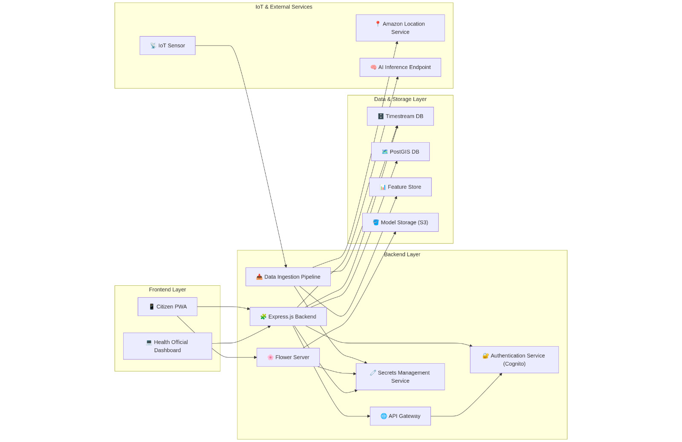
Component Diagram

Slide 23
Technology Stack
Frontend – React, React-Leaflet, Chart.js
Backend – Node.js, Express.js
Cloud – AWS (IoT Core, Kinesis, Lambda, SageMaker, RDS, S3, Cognito)
AI/ML – Python, TensorFlow.js, Graph Transformers
Federated Learning – Flower
IoT Hardware – ESP32
Protocols – MQTT, HTTPS, gRPC

Slide 24
Quality & Security Framework
Pillar 1: Data Security – HTTPS/TLS, encrypted databases
Pillar 2: Privacy by Design – Federated Learning, no personal data stored
Pillar 3: Access Security – Cognito, RBAC for roles
Pillar 4: Data Quality – Cross-verification with multiple sources

Slide 25
Expected Impact
For Public Health Officials – Real-time insights, proactive decisions
For Citizens – Private participation and awareness
For Researchers – High-resolution, privacy-safe dataset

Slide 26
Challenges & Mitigation
Data Noise – Multi-source triangulation
Citizen Adoption – Privacy-first transparency
Sensor Maintenance – Automated Lambda health checks

Slide 27
Future Work
• Scale network across Pune region
• Refine AI with causal inference models
• Integrate with smart city dashboards
• Add more proxy data (traffic, mobility)

Slide 28
Expected Impact
For Public Health Officials – Real-time insights, proactive decisions
For Citizens – Private participation and awareness
For Researchers – High-resolution, privacy-safe dataset

Slide 29
Thank you

